Slide 1
Logistic Regression
Hongning Wang
CS@UVa

Slide 2
Today’s lecture
Logistic regression model
A discriminative classification model
Two different perspectives to derive the model
Parameter estimation

Slide 3





Review: Bayes risk
Risk – assign instance to a wrong class
$y^{∗}=argmax_{y}P(y|X)$
*Optimal Bayes decision boundary
$$p(X,y)$$
We have learned multiple ways to estimate this
$$\hat{y}=0$$
$$\hat{y}=1$$
$$p\left(X | y=0\right)p(y=0)$$
$$p\left(X | y=1\right)p(y=1)$$
$$X$$
False negative
False positive

Slide 4
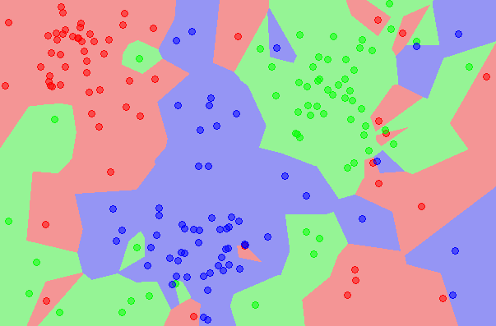
Instance-based solution
k nearest neighbors
Approximate Bayes decision rule in a subset of data around the testing point

Slide 5


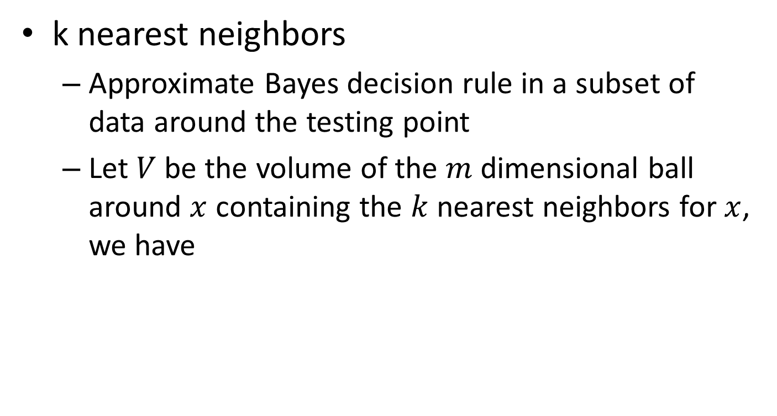



Instance-based solution
k nearest neighbors
Approximate Bayes decision rule in a subset of data around the testing point
Let $V$ be the volume of the $m$ dimensional ball around $x$ containing the $k$ nearest neighbors for $x$, we have
$$p\left(x\right)V=\frac{k}{N}$$
$$p\left(x\right)=\frac{k}{NV}$$
$$p\left(x|y=1\right)=\frac{k_{1}}{N_{1}V}$$
$$p\left(y=1\right)=\frac{N_{1}}{N}$$
=>
Total number of instances
With Bayes rule:
$$p\left(y=1|x\right)=\frac{\frac{N_{1}}{N}×\frac{k_{1}}{N_{1}V}}{\frac{k}{NV}}=\frac{k_{1}}{k}$$
Total number of instances in class 1
Counting the nearest neighbors from class1

Slide 6


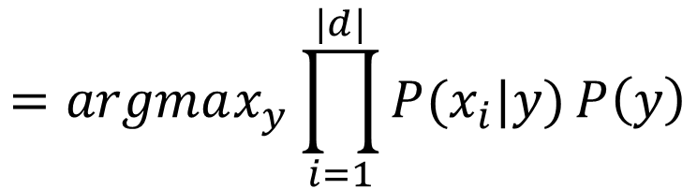
Generative solution
Naïve Bayes classifier
$y^{∗}=argmax_{y}P\left(y | X\right)$
$$=argmax_{y}P\left(X | y\right)P(y)$$
By Bayes rule
$$=argmax_{y}\prod_{i=1}^{|d|}{P(x_{i}|y)}P\left(y\right)$$
By independence assumption
y
x₁
x₂
x₃
…
x_{v}

Slide 7
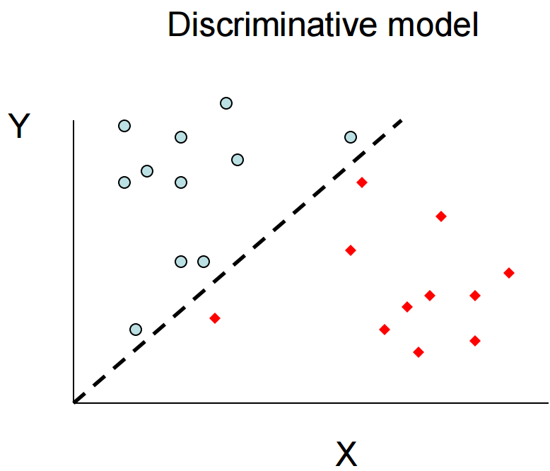
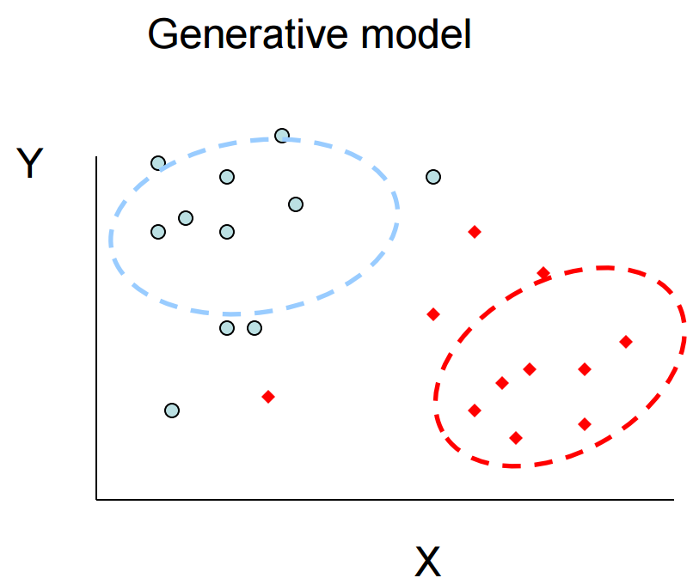

Discriminative v.s. generative models
All instances are considered for probability density estimation
$$y=f(x)$$
More attention will be put onto the boundary points

Slide 8
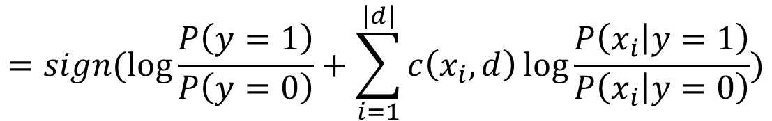




Parametric form of decision boundary in Naïve Bayes
For binary case
$f\left(X\right)=sign(\log{P\left(y=1 | X\right)−\log{P(y=0|X))}}$
$$=sign(\log{\frac{P\left(y=1\right)}{P\left(y=0\right)}}+\sum_{i=1}^{\left|d\right|}{c\left(x_{i},d\right)\log{\frac{P\left(x_{i} | y=1\right)}{P\left(x_{i} | y=0\right)}}})$$
$$=sign(w^{T}\overline{X})$$
Linear regression?
where
$$w=(\log{\frac{P\left(y=1\right)}{P\left(y=0\right)}},\log{\frac{P\left(x_{1} | y=1\right)}{P\left(x_{1} | y=0\right)}},…,\log{\frac{P\left(x_{v} | y=1\right)}{P\left(x_{v} | y=0\right)}})$$
$$\overline{X}=(1,c(x_{1},d),…,c(x_{v},d))$$

Slide 9
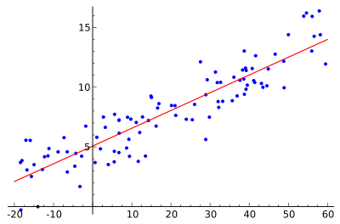

Regression for classification?
Linear regression
$y←w^{T}X$
Relationship between a scalar dependent variable $y$ and one or more explanatory variables

Slide 10
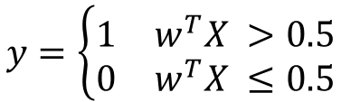

Regression for classification?
Linear regression
$y←w^{T}X$
relationship between a scalar dependent variable y and one or more explanatory variables
Y is discrete in classification problem!
y
$$y=\left\{\begin{matrix}1 & w^{T}X >0.5 \\ 0 & w^{T}X ≤0.5\end{matrix}\right.$$
1.00
0.75
What if we have an outlier?
0.50
Optimal regression model
0.25
0.00
x

Slide 11

Regression for classification?
Logistic regression
$p\left(y | x\right)=σ\left(w^{T}X\right)=\frac{1}{1+exp⁡(−w^{T}X)}$
Directly modeling of class posterior
P(y|x)
1.00
0.75
What if we have an outlier?
0.50
0.25
0.00
x

Slide 12


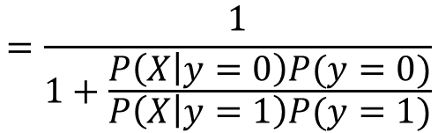


Logistic regression for classification
Why sigmoid function?
$P\left(y=1 | X\right)=\frac{P\left(X | y=1\right)P(y=1)}{P\left(X | y=1\right)P\left(y=1\right)+P\left(X | y=0\right)P(y=0)}$
$$=\frac{1}{1+\frac{P\left(X | y=0\right)P(y=0)}{P\left(X | y=1\right)P(y=1)}}$$
Binomial
P(y|x)
$$P\left(y=1\right)=α$$
1.00
0.75
$$P\left(X | y=1\right)=N(μ_{1},δ^{2})$$
$$P\left(X | y=0\right)=N(μ_{0},δ^{2})$$
0.50
0.25
Normal with identical variance
0.00
x

Slide 13
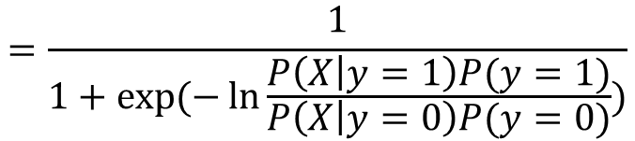
Logistic regression for classification
Why sigmoid function?
$P\left(y=1 | X\right)=\frac{P\left(X | y=1\right)P(y=1)}{P\left(X | y=1\right)P\left(y=1\right)+P\left(X | y=0\right)P(y=0)}$
$$=\frac{1}{1+\frac{P\left(X | y=0\right)P(y=0)}{P\left(X | y=1\right)P(y=1)}}$$
$$=\frac{1}{1+\exp{(−\ln{\frac{P\left(X | y=1\right)P(y=1)}{P\left(X | y=0\right)P(y=0)}})}}$$

Slide 14
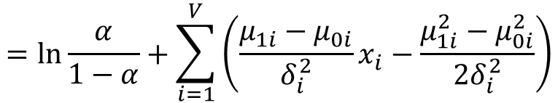




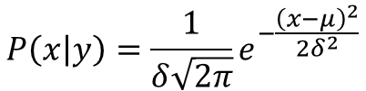
Logistic regression for classification
$$P\left(x | y\right)=\frac{1}{δ\sqrt{2π}}e^{−\frac{{\left(x−μ\right)}^{2}}{2δ^{2}}}$$
Why sigmoid function?
$\ln{\frac{P\left(X | y=1\right)P(y=1)}{P\left(X | y=0\right)P(y=0)}}=\ln{\frac{P(y=1)}{P(y=0)}}+\sum_{i=1}^{V}{\ln{\frac{P(x_{i}|y=1)}{P(x_{i}|y=0)}}}$
$$=\ln{\frac{α}{1−α}}+\sum_{i=1}^{V}{\left(\frac{μ_{1i}−μ_{0i}}{δ_{i}^{2}}x_{i}−\frac{μ_{1i}^{2}−μ_{0i}^{2}}{{2δ}_{i}^{2}}\right)}$$
$$=w_{0}+\sum_{i=1}^{V}{\frac{μ_{1i}−μ_{0i}}{δ_{i}^{2}}x_{i}}$$
$$=w_{0}+w^{T}X$$
$$={\overline{w}}^{T}\overline{X}$$

Slide 15
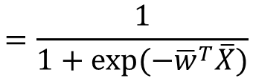
Logistic regression for classification
Why sigmoid function?
$P\left(y=1 | X\right)=\frac{P\left(X | y=1\right)P(y=1)}{P\left(X | y=1\right)P\left(y=1\right)+P\left(X | y=0\right)P(y=0)}$
$$=\frac{1}{1+\frac{P\left(X | y=0\right)P(y=0)}{P\left(X | y=1\right)P(y=1)}}$$
$$=\frac{1}{1+\exp{(−\ln{\frac{P\left(X | y=1\right)P(y=1)}{P\left(X | y=0\right)P(y=0)}})}}$$
$$=\frac{1}{1+\exp{(−{\overline{w}}^{T}\overline{X})}}$$
Note: it is still linear relation among the features!

Slide 16

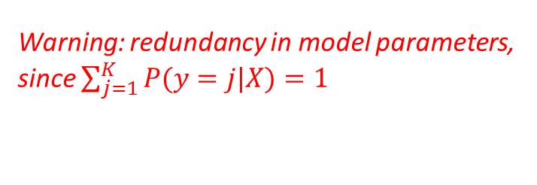


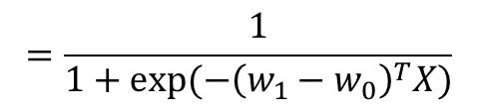

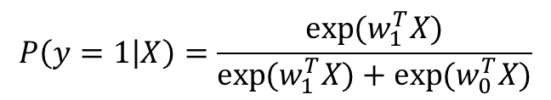
Logistic regression for classification
For multi-class categorization
$P\left(y=k | X\right)=\frac{\exp{(w_{k}^{T}X)}}{\sum_{j=1}^{K}{\exp{(w_{j}^{T}X)}}}$
$P\left(y=k | X\right)∝\exp{(w_{k}^{T}X)}$
Warning: redundancy in model parameters, since $\sum_{j=1}^{K}{P(y=j|X)}=1$
When $K$=2,
$$P\left(y=1 | X\right)=\frac{\exp{(w_{1}^{T}X)}}{\exp{(w_{1}^{T}X)}+\exp{(w_{0}^{T}X)}}$$
$$=\frac{1}{1+\exp{(−{\left(w_{1}−w_{0}\right)}^{T}X)}}$$
$$\overline{w}$$

Slide 17





Logistic regression for classification
Decision boundary for binary case
$\hat{y}=\left\{\begin{aligned}1, p\left(y=1 | X\right)>0.5 \\ 0, otherwise\end{aligned}\right.$
$\hat{y}=\left\{\begin{aligned}1, w^{T}x>0 \\ 0, otherwise\end{aligned}\right.$
$$p\left(y=1 | X\right)=\frac{1}{1+\exp{(−w^{T}X)}}>0.5$$
i.f.f.
$$\exp\left(−w^{T}X\right)<1$$
i.f.f.
$$w^{T}X>0$$
A linear model!

Slide 18



Logistic regression for classification
Decision boundary in general
$\hat{y}=argmax_{y}p\left(y | X\right)$
$$=argmax_{y}\exp{(w_{y}^{T}X)}$$
$$=argmax_{y}w_{y}^{T}X$$
A linear model!

Slide 19

Logistic regression for classification
Summary
$P\left(y=1 | X\right)=\frac{P\left(X | y=1\right)P(y=1)}{P\left(X | y=1\right)P\left(y=1\right)+P\left(X | y=0\right)P(y=0)}$
$$=\frac{1}{1+\frac{P\left(X | y=0\right)P(y=0)}{P\left(X | y=1\right)P(y=1)}}$$
Binomial
P(y|x)
$$P\left(y=1\right)=α$$
1.00
0.75
$$P\left(X | y=1\right)=N(μ_{1},δ^{2})$$
$$P\left(X | y=0\right)=N(μ_{0},δ^{2})$$
0.50
0.25
Normal with identical variance
0.00
x

Slide 20

A different perspective
Imagine we have the following
Documents
Sentiment
“happy”, “good”, “purchase”, “item”, “indeed”
positive
$$p\left(x=\text{"}\text{happy}",y=1\right)+p\left(x=\text{"}\text{good}",y=1\right)+p\left(x="purchase",y=1\right)$$
$$+p\left(x=\text{"}\text{item}\text{"},y=1\right)+p\left(x="indeed",y=1\right)=1$$
Question: find a distribution $p(x,y)$ that satisfies this observation.
Answer1:
$p\left(x=\text{"}\text{item}\text{"},y=1\right)=0$, and all the others 0
Answer2:
$p\left(x=\text{"}\text{indeed}\text{"},y=1\right)=0.5$, $p\left(x=\text{"}\text{good}\text{"},y=1\right)=0.5$, and all the others 0
We have too little information to favor either one of them.

Slide 21
Occam's razor
A problem-solving principle
“among competing hypotheses that predict equally well, the one with the fewest assumptions should be selected.”
William of Ockham (1287–1347)
Principle of Insufficient Reason: "when one has no information to distinguish between the probability of two events, the best strategy is to consider them equally likely”
Pierre-Simon Laplace (1749–1827)

Slide 22

A different perspective
Imagine we have the following
Documents
Sentiment
“happy”, “good”, “purchase”, “item”, “indeed”
positive
$$p\left(x=\text{"}\text{happy}",y=1\right)+p\left(x=\text{"}\text{good}",y=1\right)+p\left(x="purchase",y=1\right)$$
$$+p\left(x=\text{"}\text{item}\text{"},y=1\right)+p\left(x="indeed",y=1\right)=1$$
Question: find a distribution $p(x,y)$ that satisfies this observation.
As a result, a safer choice would be:
$$p\left(x=\text{"}⋅\text{"},y=1\right)=0.2$$
Equally favor every possibility

Slide 23

A different perspective
Imagine we have the following
Observations
Sentiment
“happy”, “good”, “purchase”, “item”, “indeed”
positive
30% of time “good”, “item”
positive
$$p\left(x=\text{"}\text{happy}",y=1\right)+p\left(x=\text{"}\text{good}",y=1\right)+p\left(x="purchase",y=1\right)$$
$$+p\left(x=\text{"}\text{item}\text{"},y=1\right)+p\left(x="indeed",y=1\right)=1$$
$$p\left(x=\text{"}\text{good}",y=1\right)+p\left(x=\text{"}\text{item}\text{"},y=1\right)=0.3$$
Question: find a distribution $p(x,y)$ that satisfies this observation.
Again, a safer choice would be:
$p\left(x=\text{"}good\text{"},y=1\right)=p\left(x=\text{"}item\text{"},y=1\right)=0.15$,
and all the others $\frac{7}{30}$
Equally favor every possibility

Slide 24
A different perspective
Imagine we have the following
Observations
Sentiment
“happy”, “good”, “purchase”, “item”, “indeed”
positive
30% of time “good”, “item”
positive
50% of time “good”, “happy”
positive
$$p\left(x=\text{"}\text{happy}",y=1\right)+p\left(x=\text{"}\text{good}",y=1\right)+p\left(x="purchase",y=1\right)$$
$$+p\left(x=\text{"}\text{item}\text{"},y=1\right)+p\left(x="indeed",y=1\right)=1$$
$$p\left(x=\text{"}\text{good}",y=1\right)+p\left(x=\text{"}\text{item}\text{"},y=1\right)=0.3$$
$$p\left(x=\text{"}\text{good}",y=1\right)+p\left(x=\text{"}\text{happy}\text{"},y=1\right)=0.5$$
Question: find a distribution $p(x,y)$ that satisfies this observation.
Time to think about:
1) what do we mean by equally/uniformly?
2) given all these constraints, how could we find the most preferred model?

Slide 25
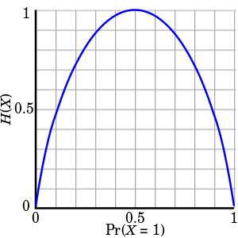


Maximum entropy modeling
A measure of uncertainty of random events
$H\left(X\right)=E\left[I\left(X\right)\right]=−\sum_{x∈X}{P\left(x\right)\log{P(x)}}$
Maximized when P(X) is uniform distribution
Question 1 is answered, then how about question 2?

Slide 26
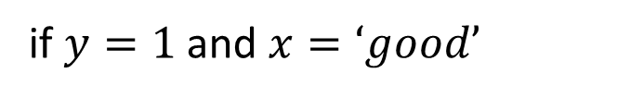
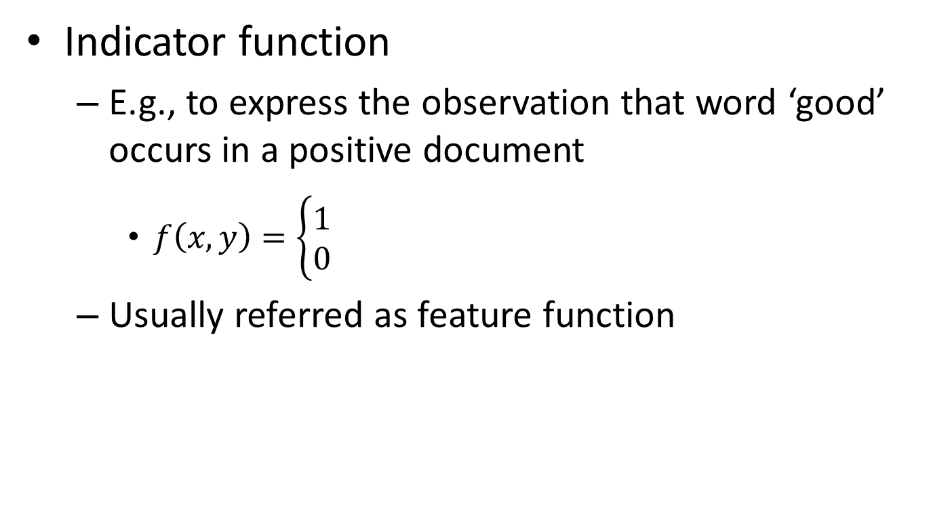
Represent the constraints
Indicator function
E.g., to express the observation that word ‘good’ occurs in a positive document
$f\left(x,y\right)=\left\{\begin{aligned}1 \\ 0\end{aligned}\right.$
Usually referred as feature function
if $y=1$ and $x=‘good’$
otherwise

Slide 27

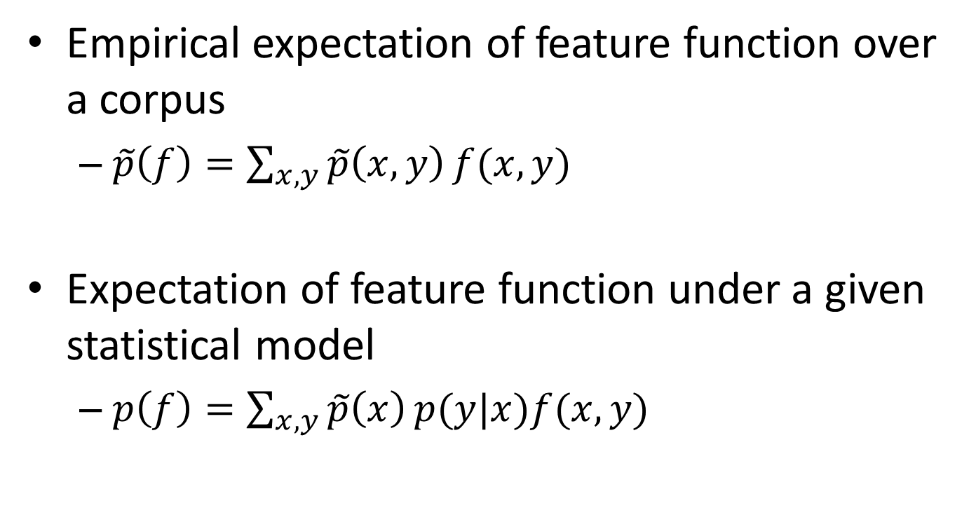
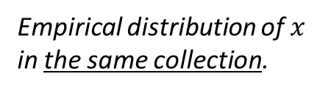
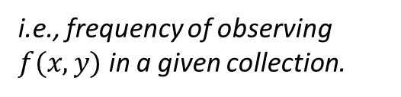
Represent the constraints
Empirical expectation of feature function over a corpus
$\tilde{p}\left(f\right)=\sum_{x,y}{\tilde{p}\left(x,y\right)}f(x,y)$
Expectation of feature function under a given statistical model
$p\left(f\right)=\sum_{x,y}{\tilde{p}\left(x\right)}p(y|x)f(x,y)$
where $\tilde{p}\left(x,y\right)=\frac{c(f(x,y))}{N}$
i.e., frequency of observing $f(x,y)$ in a given collection.
Empirical distribution of $x$ in the same collection.
Model’s estimation of conditional distribution.

Slide 28
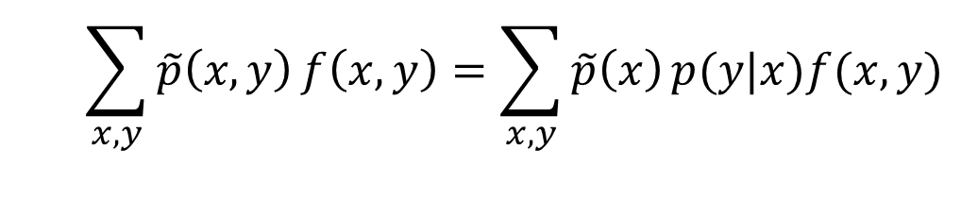

Represent the constraints
When a feature is important, we require our preferred model to accord with it
$p\left(f\right)=\tilde{p}\left(f\right)$
$$\sum_{x,y}{\tilde{p}\left(x,y\right)}f\left(x,y\right)=\sum_{x,y}{\tilde{p}\left(x\right)}p(y|x)f(x,y)$$
We only need to specify this in our preferred model!

